Slide 1
Chapter 6
Learning

Slide 2
Outline
Learning from Examples/Observation
Knowledge in Learning
Learning Probabilistic Models
Neural Networks

Slide 3
Introduction to Learning
Machine Learning is the study of how to build computer systems that adapt and improve with experience.
It is a subfield of Artificial Intelligence and intersects with cognitive science, information theory, and probability theory, among others.
Classical AI deals mainly with deductive reasoning, learning represents inductive reasoning.
Deductive reasoning arrives at answers to queries relating to a particular situation starting from a set of general axioms, whereas inductive reasoning arrives at general axioms from a set of particular instances.
Classical AI often suffers from the knowledge acquisition problem in real life applications where obtaining and updating the knowledge base is costly and prone to errors.
Machine learning serves to solve the knowledge acquisition bottleneck by obtaining the result from data by induction.

Slide 4
Introduction to Learning … Cont’d
Machine learning is particularly attractive in several real life problem because of the following reasons:
• Some tasks cannot be defined well except by example
• Working environment of machines may not be known at design time
• Explicit knowledge encoding may be difficult and not available
• Environments change over time
• Biological systems learn
Recently, learning is widely used in a number of application areas including,
• Data mining and knowledge discovery
• Speech/image/video (pattern) recognition
• Adaptive control
• Autonomous vehicles/robots
• Decision support systems
• Bioinformatics
• WWW

Slide 5
Introduction to Learning … Cont’d
Formally, a computer program is said to learn from experience E with respect to some class of tasks T and performance measure P, if its performance at tasks in T, as measured by P, improves with experience E.
Thus a learning system is characterized by:
• task T
• experience E, and
• performance measure P
Examples:
Learning to play chess
T: Play chess
P: Percentage of games won in world tournament
E: Opportunity to play against self or other players
Learning to drive a van
T: Drive on a public highway using vision sensors
P: Average distance traveled before an error (according to human observer)
E: Sequence of images and steering actions recorded during human driving.

Slide 6
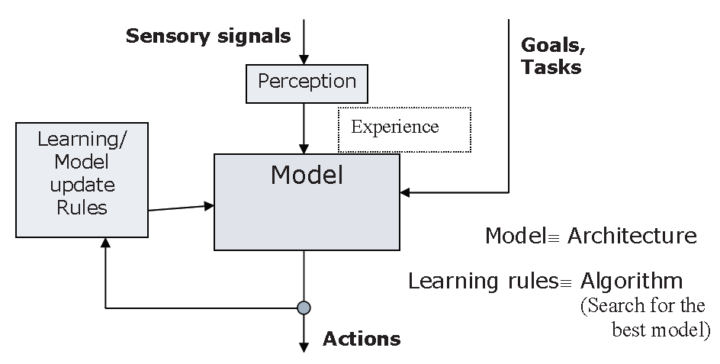
Introduction to Learning … Cont’d
The block diagram of a generic learning system which can realize the above definition is shown below:

Slide 7
Introduction to Learning … Cont’d
As can be seen from the above diagram the system consists of the following components:
• Goal: Defined with respect to the task to be performed by the system
• Model: A mathematical function which maps perception to actions
• Learning rules: Which update the model parameters with new experience such that the performance measures with respect to the goals is optimized
• Experience: A set of perception (and possibly the corresponding actions)

Slide 8
Taxonomy of Learning Systems
Several classification of learning systems are possible based on the above components as follows:
Goal/Task/Target Function:
Prediction: To predict the desired output for a given input based on previous input/output pairs. E.g., to predict the value of a stock given other inputs like market index, interest rates etc.
Categorization: To classify an object into one of several categories based on features of the object. E.g., a robotic vision system to categorize a machine part into one of the categories, spanner, hammer etc based on the parts’ dimension and shape.
Clustering: To organize a group of objects into homogeneous segments. E.g., a satellite image analysis system which groups land areas into forest, urban and water body, for better utilization of natural resources.
Planning: To generate an optimal sequence of actions to solve a particular problem. E.g., an Unmanned Air Vehicle which plans its path to obtain a set of pictures and avoid enemy anti-aircraft guns.

Slide 9
Taxonomy of Learning Systems … Cont’d
Models:
Propositional and FOL rules
Decision trees
Linear separators
Neural networks
Graphical models
Temporal models like hidden Markov models
Learning Rules:
Learning rules are often tied up with the model of learning used.
Some common rules are gradient descent, least square error, expectation maximization and margin maximization.

Slide 10
Taxonomy of Learning Systems … Cont’d
Experiences:
Learning algorithms use experiences in the form of perceptions or perception action pairs to improve their performance. The nature of experiences available varies with applications. Some common situations are described below.
Supervised learning: In supervised learning a teacher or oracle is available which provides the desired action corresponding to a perception. A set of perception action pair provides what is called a training set. Examples include an automated vehicle where a set of vision inputs and the corresponding steering actions are available to the learner.
Unsupervised learning: In unsupervised learning no teacher is available. The learner only discovers persistent patterns in the data consisting of a collection of perceptions. This is also called exploratory learning. Finding out malicious network attacks from a sequence of anomalous data packets is an example of unsupervised learning.

Slide 11
Taxonomy of Learning Systems … Cont’d
Active learning: Here not only a teacher is available, the learner has the freedom to ask the teacher for suitable perception-action example pairs which will help the learner to improve its performance. Consider a news recommender system which tries to learn an users preferences and categorize news articles as interesting or uninteresting to the user. The system may present a particular article (of which it is not sure) to the user and ask whether it is interesting or not.
Reinforcement learning: In reinforcement learning a teacher is available, but the teacher instead of directly providing the desired action corresponding to a perception, return reward and punishment to the learner for its action corresponding to a perception. Examples include a robot in a unknown terrain where its get a punishment when its hits an obstacle and reward when it moves smoothly.
In order to design a learning system the designer has to make the following choices based on the application.

Slide 12
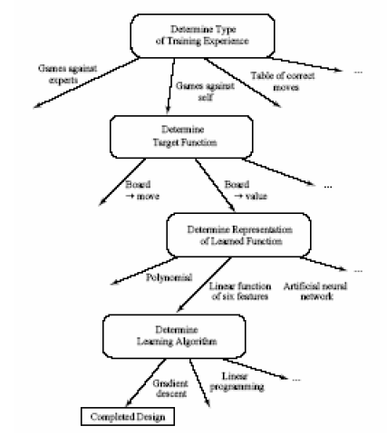
Taxonomy of Learning Systems … Cont’d

Slide 13
Mathematical formulation of the inductive learning problem
Extrapolate from a given set of examples so that we can make accurate predictions about future examples.
Supervised versus Unsupervised learning Want to learn an unknown function f(x) = y, where x is an input example and y is the desired output. Supervised learning implies we are given a set of (x, y) pairs by a "teacher." Unsupervised learning means we are only given the xs.
In either case, the goal is to estimate f.

Slide 14
Mathematical formulation of the inductive learning problem … Cont’d
Inductive Bias
Inductive learning is an inherently conjectural process because any knowledge created by generalization from specific facts cannot be proven true; it can only be proven false. Hence, inductive inference is falsity preserving, not truth preserving.
To generalize beyond the specific training examples, we need constraints or biases on what f is best. That is, learning can be viewed as searching the Hypothesis Space H of possible f functions.
A bias allows us to choose one f over another one
A completely unbiased inductive algorithm could only memorize the training examples and could not say anything more about other unseen examples.
Two types of biases are commonly used in machine learning:
Restricted Hypothesis Space Bias Allow only certain types of f functions, not arbitrary ones

Slide 15
Mathematical formulation of the inductive learning problem … Cont’d
Preference Bias Define a metric for comparing fs so as to determine whether one is better than another
Inductive Learning Framework
Raw input data from sensors are preprocessed to obtain a feature vector, x, that adequately describes all of the relevant features for classifying examples.
Each x is a list of (attribute, value) pairs. For example,
x = (Person = Sue, Eye-Color = Brown, Age = Young, Sex = Female)
The number of attributes (also called features) is fixed (positive, finite). Each attribute has a fixed, finite number of possible values.
Each example can be interpreted as a point in an n-dimensional feature space, where n is the number of attributes.

Slide 16
Learning From Observations
Concept Learning
Definition:
The problem is to learn a function mapping examples into two classes: positive and negative. We are given a database of examples already classified as positive or negative. Concept learning: the process of inducing a function mapping input examples into a Boolean output.
Examples:
Classifying objects in astronomical images as stars or galaxies
Classifying animals as vertebrates or invertebrates
Example: Classifying Mushrooms
Class of Tasks: Predicting poisonous mushrooms
Performance: Accuracy of classification
Experience: Database describing mushrooms with their class
Knowledge to learn: Function mapping mushrooms to {0,1} where 0:not-poisonous and 1:poisonous

Slide 17
Learning From Observations … Cont’d
Representation of target knowledge: conjunction of attribute values.
Learning mechanism: candidate-elimination
Representation of instances:
Features:
color {red, brown, gray}
size {small, large}
shape {round,elongated}
land {humid,dry}
air humidity {low,high}
texture {smooth, rough}
Input and Output Spaces:
X : The space of all possible examples (input space).
Y: The space of classes (output space).
An example in X is a feature vector X.
For instance: X = (red,small,elongated,humid,low,rough)
X is the cross product of all feature values.
Only a small subset of instances is available in the database of examples.

Slide 18
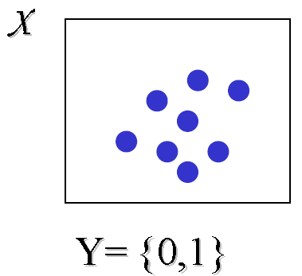
Learning From Observations … Cont’d
Training Examples:
D : The set of training examples.
D is a set of pairs { (x,c(x)) }, where c is the target concept. c is a subset of the universe of discourse or the set of all possible instances.
Example of D:
((red,small,round,humid,low,smooth), poisonous)
((red,small,elongated,humid,low,smooth), poisonous)
((gray,large,elongated,humid,low,rough), not-poisonous)
((red,small,elongated,humid,high,rough), poisonous)

Slide 19
Learning From Observations … Cont’d
Hypothesis Representation
Any hypothesis h is a function from X to Y
h: X Y
We will explore the space of conjunctions.
Special symbols:
? Any value is acceptable
0 no value is acceptable
Consider the following hypotheses:
(?,?,?,?,?,?): all mushrooms are poisonous
(0,0,0,0,0,0): no mushroom is poisonous

Slide 20
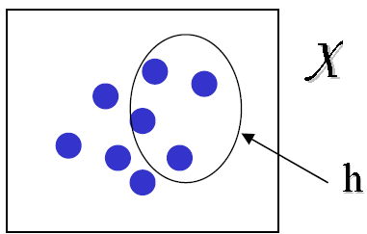
Learning From Observations … Cont’d
Hypotheses Space:
The space of all hypotheses is represented by H
Let h be a hypothesis in H.
Let X be an example of a mushroom.
if h(X) = 1 then X is poisonous, otherwise X is not-poisonous
Our goal is to find the hypothesis, h*, that is very “close” to target concept c.
A hypothesis is said to “cover” those examples it classifies as positive.

Slide 21
Learning From Observations … Cont’d
Assumptions:
We will explore the space of all conjunctions.
We assume the target concept falls within this space.
A hypothesis close to target concept c obtained after seeing many training examples will result in high accuracy on the set of unobserved examples. (Inductive Learning Hypothesis)

Slide 22
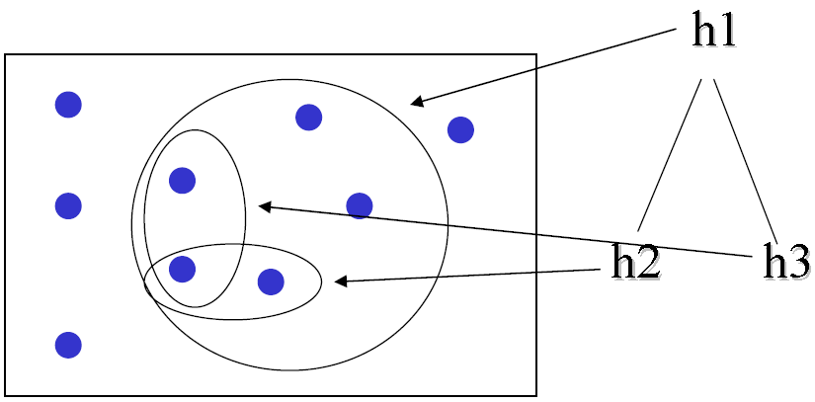
Concept Learning as Search
We will see how the problem of concept learning can be posed as a search problem.
We will illustrate that there is a general to specific ordering inherent to any hypothesis space.
Consider these two hypotheses:
h1 = (red,?,?,humid,?,?)
h2 = (red,?,?,?,?,?)
We say h2 is more general than h1 because h2 classifies more instances than h1 and h1 is covered by h2.
For example, consider the following hypotheses

Slide 23
Concept Learning as Search … Cont’d
h1 is more general than h2 and h3.
h2 and h3 are neither more specific nor more general than each other.
Definitions:
Let hj and hk be two hypotheses mapping examples into {0,1}.
We say hj is more general than hk iff
For all examples X, hk(X) = 1 hj(X) = 1
We represent this fact as hj >= hk
The >= relation imposes a partial ordering over the hypothesis space H (reflexive, antisymmetric, and transitive).
Any input space X defines then a lattice of hypotheses ordered according to the general-specific relation:

Slide 24
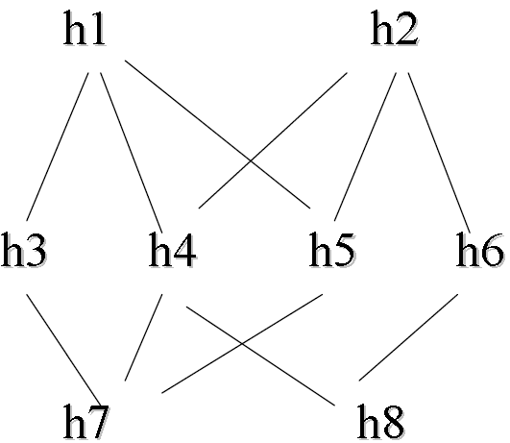

Slide 25
Algorithm to Find a Maximally-Specific Hypothesis
Algorithm to search the space of conjunctions:
Start with the most specific hypothesis
Generalize the hypothesis when it fails to cover a positive example
Algorithm:
1. Initialize h to the most specific hypothesis
2. For each positive training example X
For each value a in h
If example X and h agree on a, do nothing
Else generalize a by the next more general constraint
3. Output hypothesis h

Slide 26
Algorithm to Find a Maximally-Specific Hypothesis
Example:
Let’s run the learning algorithm above with the following examples:
((red,small,round,humid,low,smooth), poisonous)
((red,small,elongated,humid,low,smooth), poisonous)
((gray,large,elongated,humid,low,rough), not-poisonous)
((red,small,elongated,humid,high,rough), poisonous)
We start with the most specific hypothesis: h = (0,0,0,0,0,0)

Slide 27
Algorithm to Find a Maximally-Specific Hypothesis
The first example comes and since the example is positive and h fails to cover it, we simply generalize h to cover exactly this example:
h = (red,small,round,humid,low,smooth)
Hypothesis h basically says that the first example is the only positive example, all other examples are negative.
Then comes examples 2: ((red,small,elongated,humid,low,smooth), poisonous)
This example is positive. All attributes match hypothesis h except for attribute shape: it has the value elongated, not round. We generalize this attribute using symbol ? yielding:
h: (red,small,?,humid,low,smooth)
The third example is negative and so we just ignore it.
Why is it we don’t need to be concerned with negative examples?
Upon observing the 4th example, hypothesis h is generalized to the following:
h = (red,small,?,humid,?,?)
h is interpreted as any mushroom that is red, small and found on humid land should be classified as poisonous.

Slide 28
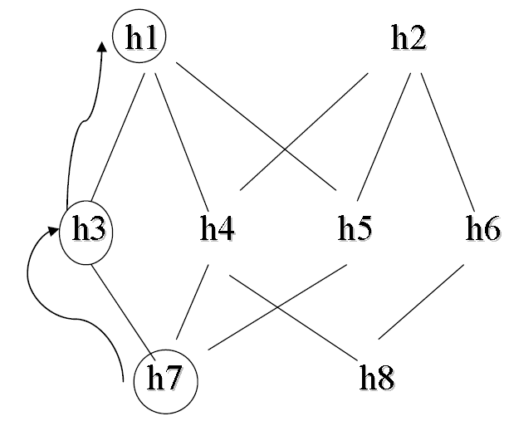
Algorithm to Find a Maximally-Specific Hypothesis

Slide 29
Algorithm to Find a Maximally-Specific Hypothesis
The algorithm is guaranteed to find the hypothesis that is most specific and consistent with the set of training examples. It takes advantage of the general-specific ordering to move on the corresponding lattice searching for the next most specific hypothesis.
Note that:
There are many hypotheses consistent with the training data D. Why should we prefer the most specific hypothesis?
What would happen if the examples are not consistent? What would happen if they have errors, noise?
What if there is a hypothesis space H where one can find more that one maximally specific hypothesis h? The search over the lattice must then be different to allow for this possibility.

Slide 30
Algorithm to Find a Maximally-Specific Hypothesis
The algorithm that finds the maximally specific hypothesis is limited in that it only finds one of many hypotheses consistent with the training data.
• The Candidate Elimination Algorithm (CEA) finds ALL hypotheses consistent with the training data.
• CEA does that without explicitly enumerating all consistent hypotheses.
• Applications:
o Chemical Mass Spectroscopy
o Control Rules for Heuristic Search

Slide 31
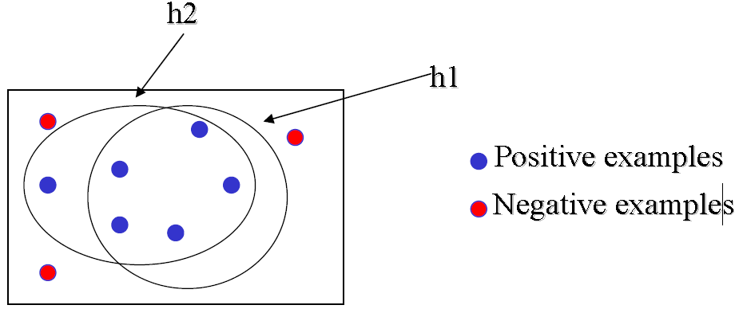
Candidate Elimination Algorithm
Consistency vs Coverage
In the following example, h1 covers a different set of examples than h2, h2 is consistent with training set D, h1 is not consistent with training set D

Slide 32
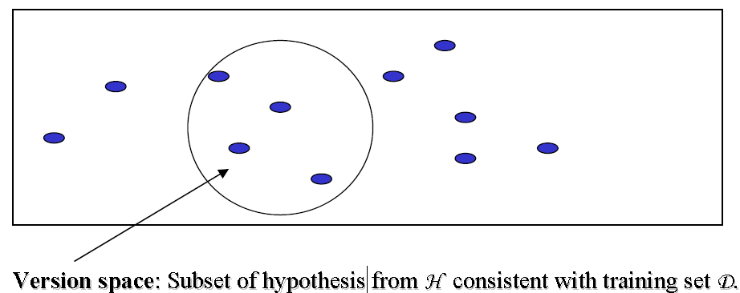
Version Space
Hypothesis Space

Slide 33
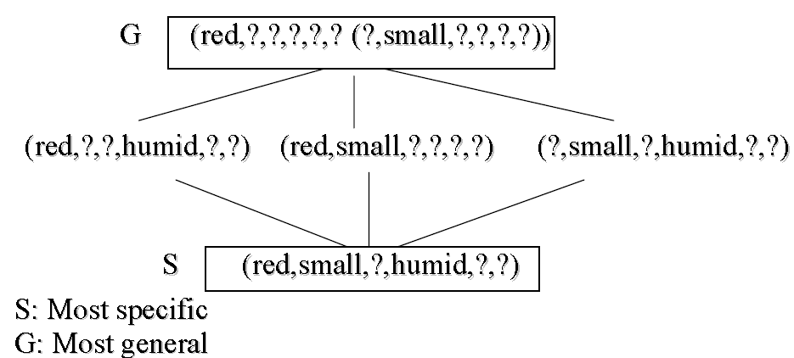
Version Space … Cont’d
The version space for the mushroom example is as follows:
The candidate elimination algorithm generates the entire version space.

Slide 34
The Candidate-Elimination Algorithm
The candidate elimination algorithm keeps two lists of hypotheses consistent with the training data: (i) The list of most specific hypotheses S and, (ii) The list of most general hypotheses G. This is enough to derive the whole version space VS.
Steps:
1. Initialize G to the set of maximally general hypotheses in H
2. Initialize S to the set of maximally specific hypotheses in H
3. For each training example X do
a) If X is positive: generalize S if necessary
b) If X is negative: specialize G if necessary
4. Output {G,S}
Step (a) Positive examples

Slide 35
The Candidate-Elimination Algorithm
If X is positive:
Remove from G any hypothesis inconsistent with X
For each hypothesis h in S not consistent with X
Remove h from S
Add all minimal generalizations of h consistent with X such that some member of G is more general than h
Remove from S any hypothesis more general than any other hypothesis in S
Step (b) Negative examples
If X is negative:
Remove from S any hypothesis inconsistent with X
For each hypothesis h in G not consistent with X
Remove g from G
Add all minimal generalizations of h consistent with X such that some member of S is more specific than h
Remove from G any hypothesis less general than any other hypothesis in G

Slide 36
The Candidate-Elimination Algorithm
The candidate elimination algorithm is guaranteed to converge to the right hypothesis provided the following:
a) No errors exist in the examples
b) The target concept is included in the hypothesis space H
If there exists errors in the examples:
a) The right hypothesis would be inconsistent and thus eliminated.
b) If the S and G sets converge to an empty space we have evidence that the true concept lies outside space H.

Slide 37
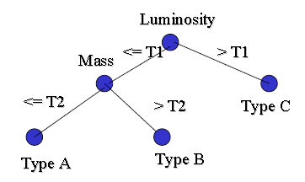
Rule Induction and Decision Tree - I
Decision Trees
Decision trees are a class of learning models that are more robust to noise as well as more powerful as compared to concept learning.
Consider the problem of classifying a star based on some astronomical measurements.
It can naturally be represented by the following set of decisions on each measurement arranged in a tree like fashion

Slide 38
Decision Tree: Definition
A decision-tree learning algorithm approximates a target concept using a tree representation, where each internal node corresponds to an attribute, and every terminal node corresponds to a class.
There are two types of nodes:
Internal node.- Splits into different branches according to the different values the corresponding attribute can take. Example: luminosity <= T1 or luminosity > T1.
Terminal Node.- Decides the class assigned to the example.

Slide 39
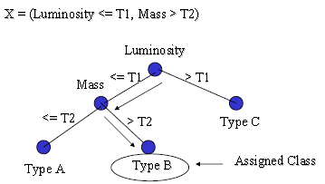
Classifying Examples Using Decision Tree
To classify an example X we start at the root of the tree, and check the value of that attribute on X.
We follow the branch corresponding to that value and jump to the next node.
We continue until we reach a terminal node and take that class as our best prediction.

Slide 40
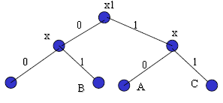
Cont’d…
Decision trees adopt a DNF (Disjunctive Normal Form) representation.
For a fixed class, every branch from the root of the tree to a terminal node with that class is a conjunction of attribute values; different branches ending in that class form a disjunction.
In the following example, the rules for class A are: (~X1 & ~x2) OR (X1 & ~x3)

Slide 41
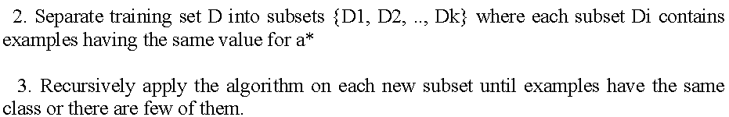
Decision Tree Construction
There are different ways to construct trees from data.
We will concentrate on the top-down, greedy search approach:
Basic idea:
1. Choose the best attribute a* to place at the root of the tree.

Slide 42
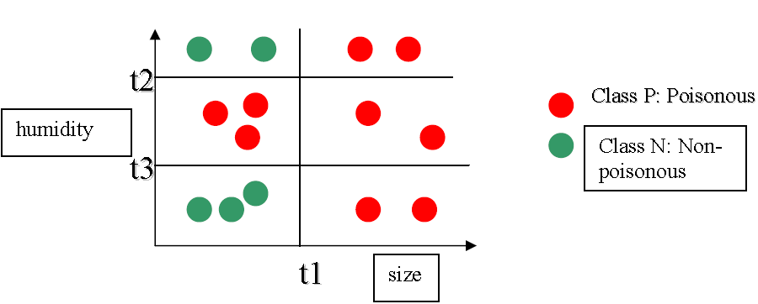

Cont’d

Slide 43
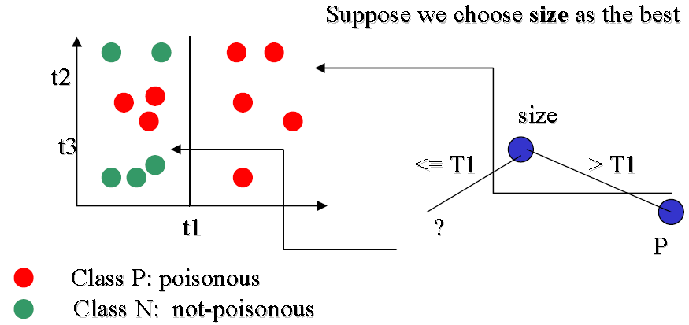
Cont’d

Slide 44
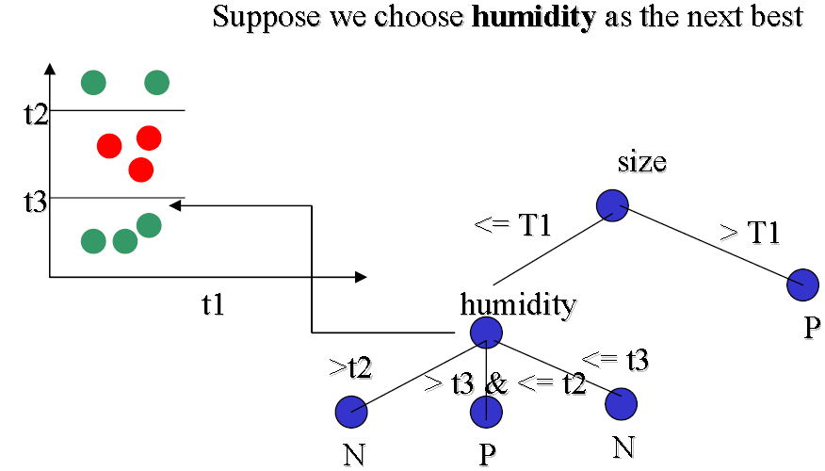
Cont’d

Slide 45
Cont’d
Steps:
• Create a root for the tree
• If all examples are of the same class or the number of examples is below a threshold return that class
• If no attributes available return majority class
• Let a* be the best attribute
• For each possible value v of a*
• Add a branch below a* labeled “a = v”
• Let Sv be the subsets of example where attribute a*=v
• Recursively apply the algorithm to Sv

Slide 46
Rule Induction and Decision Tree - II
Splitting Functions
What attribute is the best to split the data? Let us remember some definitions from information theory.
A measure of uncertainty or entropy that is associated to a random variable X is defined as
H(X) = - Σ pi log pi
where the logarithm is in base 2.
This is the “average amount of information or entropy of a finite complete probability scheme”.
We will use a entropy based splitting function.
Consider the previous example:

Slide 47
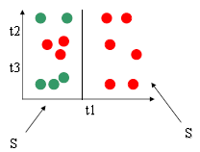
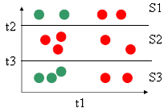
Cont’d
Size divides the sample in two.
S1 = { 6P, 0NP}
S2 = { 3P, 5NP}
H(S1) = 0
H(S2) = -(3/8)log2(3/8)
-(5/8)log2(5/8)
humidity divides the sample in three.
S1 = { 2P, 2NP}
S2 = { 5P, 0NP}
S3 = { 2P, 3NP}
H(S1) = 1
H(S2) = 0
H(S3) = -(2/5)log2(2/5)
-(3/5)log2(3/5)

Slide 48
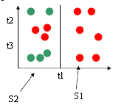
Cont’d
Let us define information gain as follows:
Information gain IG over attribute A: IG (A)
IG(A) = H(S) - Σv (Sv/S) H (Sv)
H(S) is the entropy of all examples. H(Sv) is the entropy of one subsample after partitioning S based on all possible values of attribute A.
Consider the previous example:
We have,
H(S1) = 0
H(S2) = -(3/8)log2(3/8)
-(5/8)log2(5/8)
H(S) = -(9/14)log2(9/14)
-(5/14)log2(5/14)
|S1|/|S| = 6/14
|S2|/|S| = 8/14
The principle for decision tree construction may be stated as follows:
Order the splits (attribute and value of the attribute) in decreasing order of information gain.

Slide 49
Decision Tree Pruning
Practical issues while building a decision tree can be enumerated as follows:
1) How deep should the tree be?
2) How do we handle continuous attributes?
3) What is a good splitting function?
4) What happens when attribute values are missing?
5) How do we improve the computational efficiency
The depth of the tree is related to the generalization capability of the tree. If not carefully chosen it may lead to overfitting.
A tree overfits the data if we let it grow deep enough so that it begins to capture “aberrations” in the data that harm the predictive power on unseen examples:

Slide 50
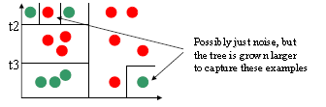
Cont’d
There are two main solutions to overfitting in a decision tree:
1) stop the tree early before it begins to overfit the data
+ In practice this solution is hard to implement because I stopping point.
2) Grow the tree until the algorithm stops even if the overfitting problem shows up.
Then prune the tree as a post-processing step.
+ This method has found great popularity in the machine learning community.

Slide 51
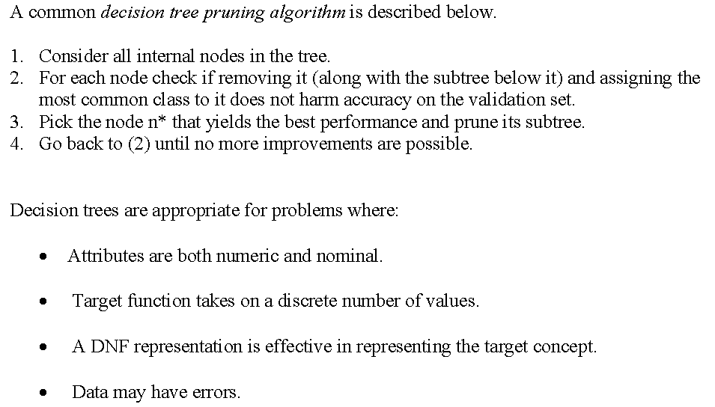
Cont’d

Slide 52
Learning and Neural Networks - I
Neural Networks
Artificial neural networks are among the most powerful learning models.
They have the versatility to approximate a wide range of complex functions representing multi-dimensional input-output maps.
Neural networks also have inherent adaptability, and can perform robustly even in noisy environments.
An Artificial Neural Network (ANN) is an information processing paradigm that is inspired by the way biological nervous systems, such as the brain, process information.
The key element of this paradigm is the novel structure of the information processing system.
It is composed of a large number of highly interconnected simple processing elements (neurons) working in unison to solve specific problems.

Slide 53
Cont’d
ANNs, like people, learn by example. An ANN is configured for a specific application, such as pattern recognition or data classification, through a learning process.
Learning in biological systems involves adjustments to the synaptic connections that exist between the neurons. This is true of ANNs as well.
ANNs can process information at a great speed owing to their highly massive parallelism.
Neural networks, with their remarkable ability to derive meaning from complicated or imprecise data, can be used to extract patterns and detect trends that are too complex to be noticed by either humans or other computer techniques.

Slide 54
Cont’d
A trained neural network can be thought of as an "expert" in the category of information it has been given to analyse.
This expert can then be used to provide projections given new situations of interest and answer "what if" questions. Other advantages include:
1. Adaptive learning: An ability to learn how to do tasks based on the data given for training or initial experience.
2. Self-Organisation: An ANN can create its own organisation or representation of the information it receives during learning time.
3. Real Time Operation: ANN computations may be carried out in parallel, and special hardware devices are being designed and manufactured which take advantage of this capability.
4. Fault Tolerance via Redundant Information Coding: Partial destruction of a network leads to the corresponding degradation of performance. However, some network capabilities may be retained even with major network damage.

Slide 55
Biological Neural Networks
Much is still unknown about how the brain trains itself to process information, so theories abound. In the human brain, a typical neuron collects signals from others through a host of fine structures called dendrites.
The neuron sends out spikes of electrical activity through a long, thin stand known as an axon, which splits into thousands of branches.
At the end of each branch, a structure called a synapse converts the activity from the axon into electrical effects that inhibit or excite activity from the axon into electrical effects that inhibit or excite activity in the connected neurones.
When a neuron receives excitatory input that is sufficiently large compared with its inhibitory input, it sends a spike of electrical activity down its axon.
Learning occurs by changing the effectiveness of the synapses so that the influence of one neuron on another changes.

Slide 56
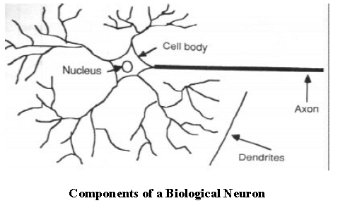
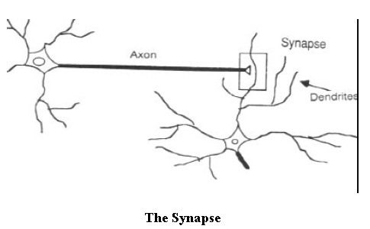
Cont’d

Slide 57
Artificial Neural Networks
Artificial neural networks are represented by a set of nodes, often arranged in layers, and a set of weighted directed links connecting them. The nodes are equivalent to neurons, while the links denote synapses. The nodes are the information processing units and the links acts as communicating media.
There are a wide variety of networks depending on the nature of information processing carried out at individual nodes, the topology of the links, and the algorithm for adaptation of link weights. Some of the popular among them include:
Perceptron: This consists of a single neuron with multiple inputs and a single output. It has restricted information processing capability. The information processing is done through a transfer function which is either linear or non-linear.

Slide 58
Cont’d
Multi-layered Perceptron (MLP): It has a layered architecture consisting of input, hidden and output layers. Each layer consists of a number of perceptrons. The output of each layer is transmitted to the input of nodes in other layers through weighted links. Usually, this transmission is done only to nodes of the next layer, leading to what are known as feed forward networks. MLPs were proposed to extend the limited information processing capabilities of simple percptrons, and are highly versatile in terms of their approximation ability. Training or weight adaptation is done in MLPs using supervised backpropagation learning.
Recurrent Neural Networks: RNN topology involves backward links from output to the input and hidden layers. The notion of time is encoded in the RNN information processing scheme. They are thus used in applications like speech processing where inputs are time sequences data.

Slide 59
Cont’d
Self-Organizing Maps: SOMs or Kohonen networks have a grid topology, wit unequal grid weights. The topology of the grid provides a low dimensional visualization of the data distribution. These are thus used in applications which typically involve organization and human browsing of a large volume of data. Learning is performed using a winner take all strategy in a unsupervised mode.

Slide 60
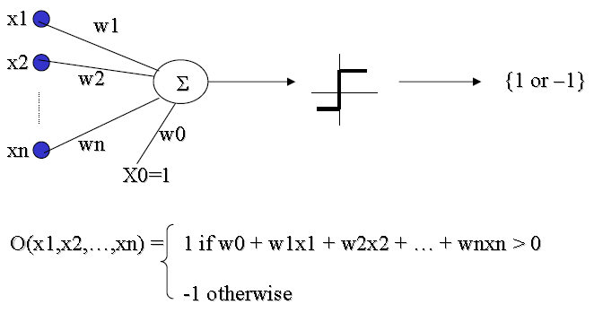
Neural Networks - II
Perceptron
Definition: It’s a step function based on a linear combination of real-valued inputs. If the combination is above a threshold it outputs a 1, otherwise it outputs a –1.

Slide 61
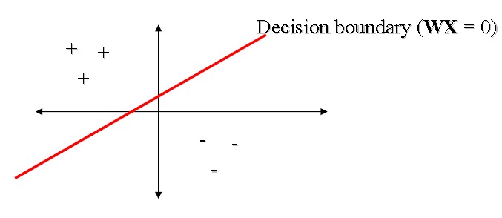
Cont’d
A perceptron draws a hyperplane as the decision boundary over the (n-dimensional) input space.
A perceptron can learn only examples that are called “linearly separable”.
These are examples that can be perfectly separated by a hyperplane.

Slide 62
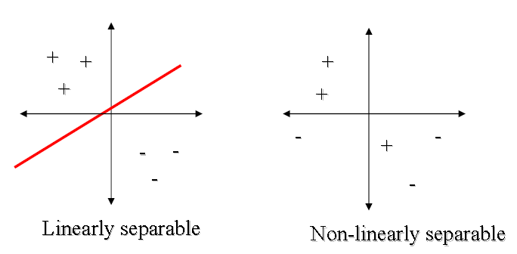
Cont’d
Perceptrons can learn many boolean functions: AND, OR, NAND, NOR, but not XOR
However, every boolean function can be represented with a perceptron network that has two levels of depth or more.
The weights of a perceptron implementing the AND function is shown below.

Slide 63
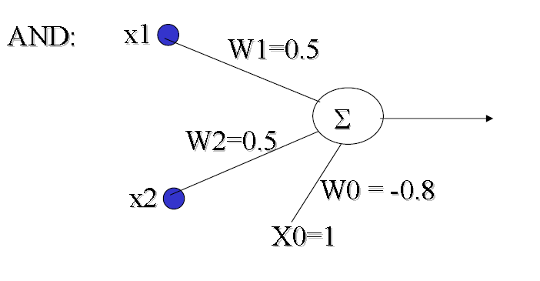
Cont’d

Slide 64
Perceptron Learning
Learning a perceptron means finding the right values for W.
The hypothesis space of a perceptron is the space of all weight vectors.
The perceptron learning algorithm can be stated as below.
1. Assign random values to the weight vector
2. Apply the weight update rule to every training example
3. Are all training examples correctly classified?
a. Yes. Quit
b. No. Go back to Step 2.
There are two popular weight update rules.
i) The perceptron rule, and
ii) Delta rule

Slide 65
The Perceptron Rule
For a new training example X = (x1, x2, …, xn), update each weight according to this rule:
wi = wi + Δwi
Where Δwi = η (t-o) xi
t: target output
o: output generated by the perceptron
η: constant called the learning rate (e.g., 0.1)
Comments about the perceptron training rule:
If the example is correctly classified the term (t-o) equals zero, and no update on the weight is necessary.
• If the perceptron outputs –1 and the real answer is 1, the weight is increased.
• If the perceptron outputs a 1 and the real answer is -1, the weight is decreased.
• Provided the examples are linearly separable and a small value for η is used, the rule is proved to classify all training examples correctly (i.e, is consistent with the training data).

Slide 66
The Delta Rule
What happens if the examples are not linearly separable?
To address this situation we try to approximate the real concept using the delta rule.
The key idea is to use a gradient descent search. We will try to minimize the following error:
E = ½ Σi (ti – oi) 2
where the sum goes over all training examples. Here oi is the inner product WX and not sgn(WX) as with the perceptron rule. The idea is to find a minimum in the space of weights and the error function E.
The delta rule is as follows:
For a new training example X = (x1, x2, …, xn), update each weight according to this rule:
wi = wi + Δwi
Where Δwi = -η E’(W)/wi
η: learning rate (e.g., 0.1)

Slide 67
Cont’d
It is easy to see that
E’(W)/ wi = Σi (ti – oi) (-xi)
So that gives us the following equation:
wi = η Σi (ti – oi) xi
There are two differences between the perceptron and the delta rule. The perceptron is based on an output from a step function, whereas the delta rule uses the linear combination of inputs directly. The perceptron is guaranteed to converge to a consistent
hypothesis assuming the data is linearly separable. The delta rules converges in the limit but it does not need the condition of linearly separable data.
There are two main difficulties with the gradient descent method:
1. Convergence to a minimum may take a long time.
2. There is no guarantee we will find the global minimum.
These are handled by using momentum terms and random perturbations to the weight vectors.

Slide 68
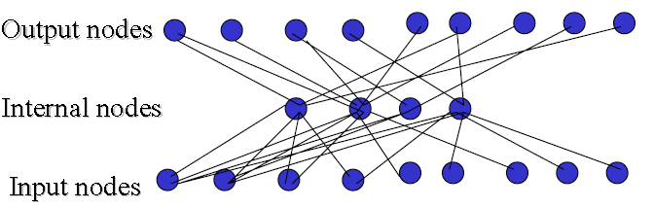
Neural Networks - III
Multi-Layer Perceptrons
In contrast to perceptrons, multilayer networks can learn not only multiple decision boundaries, but the boundaries may be nonlinear.
The typical architecture of a multi-layer perceptron (MLP) is shown below.
To make nonlinear partitions on the space we need to define each unit as a nonlinear function (unlike the perceptron). One solution is to use the sigmoid unit.
Another reason for using sigmoids are that they are continuous unlike linear thresholds and are thus differentiable at all points.

Slide 69
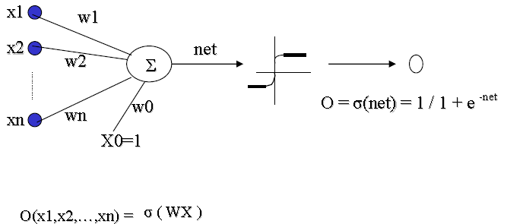
Cont’d
where: σ ( WX ) = 1 / 1 + e ^{-WX}
Function σ is called the sigmoid or logistic function. It has the following property:
d σ(y) / dy = σ(y) (1 – σ(y))

Slide 70
Back-Propagation Algorithm
Multi-layered perceptrons can be trained using the back-propagation algorithm described next.
Goal: To learn the weights for all links in an interconnected multilayer network.
We begin by defining our measure of error:
E(W) = ½ Σd Σk (tkd – okd) 2
k varies along the output nodes and d over the training examples.
The idea is to use again a gradient descent over the space of weights to find a global minimum (no guarantee).
Algorithm:
1. Create a network with nin input nodes, nhidden internal nodes, and nout output nodes.
2. Initialize all weights to small random numbers.
3. Until error is small do:
For each example X do
• Propagate example X forward through the network
• Propagate errors backward through the network

Slide 71
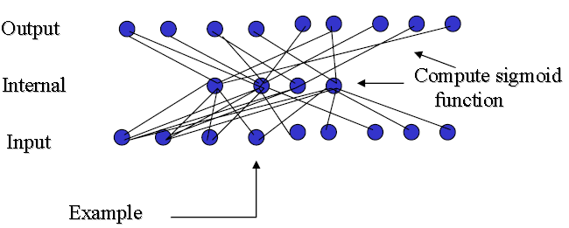
Cont’d
Forward Propagation
Given example X, compute the output of every node until we reach the output nodes:

Slide 72
Backward Propagation
A. For each output node k compute the error:
δk = Ok (1-Ok)(tk – Ok)
B. For each hidden unit h, calculate the error:
δh = Oh (1-Oh) Σk Wkh δk
C. Update each network weight:
C. Wji = Wji + ΔWji
where ΔWji = η δj Xji (Wji and Xji are the input and weight of node i to node j)
A momentum term, depending on the weight value at last iteration, may also be added to the update rule as follows. At iteration n we have the following:
ΔWji (n) = η δj Xji + αΔWji (n)
Where α ( 0 <= α <= 1) is a constant called the momentum.
1. It increases the speed along a local minimum.
2. It increases the speed along flat regions.

Slide 73
Cont’d
Remarks on Back-propagation
1. It implements a gradient descent search over the weight space.
2. It may become trapped in local minima.
3. In practice, it is very effective.
4. How to avoid local minima?
a) Add momentum.
b) Use stochastic gradient descent.
c) Use different networks with different initial values for the weights.
Multi-layered perceptrons have high representational power. They can represent the following:
1. Boolean functions. Every boolean function can be represented with a network having two layers of units.
2. Continuous functions. All bounded continuous functions can also be approximated with a network having two layers of units.
3. Arbitrary functions. Any arbitrary function can be approximated with a network with three layers of units.

Slide 74
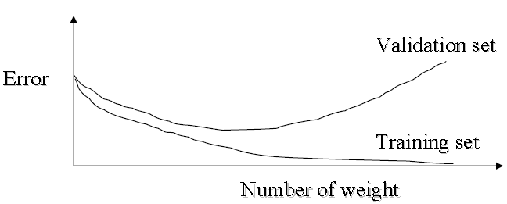
Generalization and overfitting
One obvious stopping point for backpropagation is to continue iterating until the error is below some threshold; this can lead to overfitting.
Overfitting can be avoided using the following strategies.
• Use a validation set and stop until the error is small in this set.
• Use 10 fold cross validation.
• Use weight decay; the weights are decreased slowly on each iteration.

Slide 75
Applications of Neural Networks
Neural networks have broad applicability to real world business problems. They have already been successfully applied in many industries.
Since neural networks are best at identifying patterns or trends in data, they are well suited for prediction or forecasting needs including:
• sales forecasting
• industrial process control
• customer research
• data validation
• risk management
• target marketing
Because of their adaptive and non-linear nature they have also been used in a number of control system application domains like, • process control in chemical plants • unmanned vehicles • robotics • consumer electronics
Neural networks are also used a number of other applications which are too hard to model using classical techniques. These include, computer vision, path planning and user modeling.

